Slide 1
Chapter 9 - Parameters
Srikar Mylavarapu

Slide 2
Questions from last time
I either forgot them, lost the post it where I put them, or we didn’t have any. It was kind of a rush
Some linguistics. We’re focusing on the ‘keywords and structures’ to build up C#. Hooray…
First 13 chapters basically dedicate to basics, and then → 19 are slightly more complicated; and then it’s the actual stuff.
If I were to do this again, I’d probably have a running list of keywords and definitions

Slide 3
Silly Semantics
Argument List vs parameter list
‘Args are actual’
Order matters
In general it goes arguments; named; → rest

Slide 4
Optional and Named Arguments
Guidelines:
* This can be dangerous
*honestly, be as explicit as you can

Slide 5
Optional and Default ParamValue Attributes
[DefaultParameterValue,Optional]
-- Basically this uses a compiler/IL trick to ‘capture this value’ at compilation and retrieve it at run time
--the two implementations are basically identical expect for the Interopservices

Slide 6
They’re essentially the same
.method assembly hidebysig static void '<<Main>$>g__Test1|0_0'([opt] string p1,
[opt] string p2) cil managed
{
.custom instance void System.Runtime.CompilerServices.NullableContextAttribute::.ctor(uint8) = ( 01 00 01 00 00 )
.custom instance void [System.Runtime]System.Runtime.CompilerServices.CompilerGeneratedAttribute::.ctor() = ( 01 00 00 00 )
.param [1] = "param1"
.param [2] = "param2"
// Code size 20 (0x14)
.maxstack 8
IL_0000: nop
IL_0001: ldarg.0
IL_0002: ldstr " "
IL_0007: ldarg.1
IL_0008: call string [System.Runtime]System.String::Concat(string,
string,
string)
IL_000d: call void [System.Console]System.Console::WriteLine(string)
IL_0012: nop
IL_0013: ret
} // end of method Program::'<<Main>$>g__Test1|0_0'
.method assembly hidebysig static void '<<Main>$>g__Test2|0_1'([opt] string p1,
[opt] string p2) cil managed
{
.custom instance void System.Runtime.CompilerServices.NullableContextAttribute::.ctor(uint8) = ( 01 00 01 00 00 )
.custom instance void [System.Runtime]System.Runtime.CompilerServices.CompilerGeneratedAttribute::.ctor() = ( 01 00 00 00 )
.param [1] = "param1"
.param [2] = "param2"
// Code size 20 (0x14)
.maxstack 8
IL_0000: nop
IL_0001: ldarg.0
IL_0002: ldstr " "
IL_0007: ldarg.1
IL_0008: call string [System.Runtime]System.String::Concat(string,
string,
string)
IL_000d: call void [System.Console]System.Console::WriteLine(string)
IL_0012: nop
IL_0013: ret
} // end of method Program::'<<Main>$>g__Test2|0_1'

Slide 7
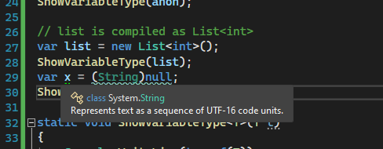
Implicitly Typed Local Variables
You can use your cursor to figure it out
Also works as expected
Can’t use null

Slide 8
Can you declare a method parameter using var?
According to ya boy Jeff, it should be OBVIOUS that you cannot
(compiler would have to infer the type) → that just leads to complications in a language where type safety is a thing

Slide 9
Parameters by Reference
On that note, CLR assumes all method parameters are passed by value
You can use pass by reference with ‘out’ or ‘ref’ → identical except for 1 bit, so if you really want to save bits at scale,
They are basically interchangeable
Can you overload based on out and ref?
Recommend looking over examples on 217, 218

Slide 10
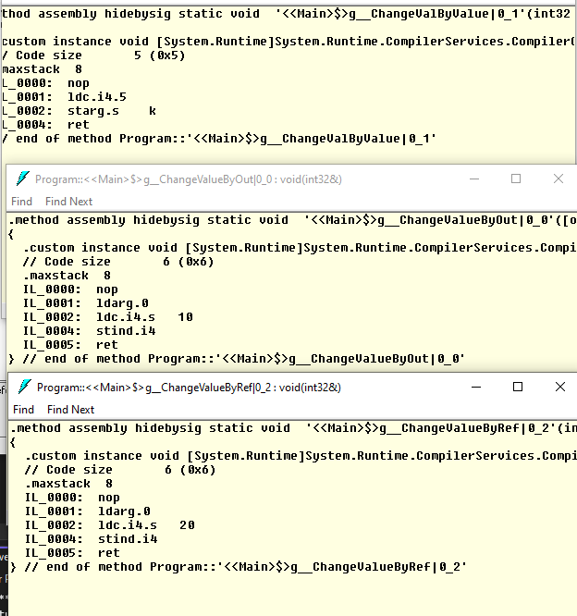
Differences?

Slide 11
Variable number of arguments to a method
Quite literally, passing a parameters array of length n
Keyword → params
Static int add(params int[]values) add(new int []{1,2,,3,4,5}) = 15
What do we think this looks like in IL?

Slide 12
Guidelines
Use weakest parameter possible (i.e. interface over base class)
What does that look like in CSharpChess?
Write for broader classes
SPFile vs AntlerSPFileThatHasBeenThrownIntoFileShredder
Return the Strongest value possible
ATM return an int + currency?

Slide 13
Const-ness
This concept of constant does not exist in the CLR, ergo not in C#
Stop crying – Jeff
Some C++ fun if we have time

